Slide 1

Used-Car Price Prediction

Slide 2
Project Overview
The goal of the car price prediction project is to create a machine learning model that can accurately predict the price of a car based on various features such as brand, model, year, mileage, fuel type, and other specifications.
Data Source: Kaggle Platform.
Features:
Car brand and model (Name)
Selling price
Km Driven
Year of manufacture
Mileage
Engine
Fuel type (petrol, diesel, electric, etc.)
Transmission type (manual, automatic)
Number of owners
Seats

Slide 3
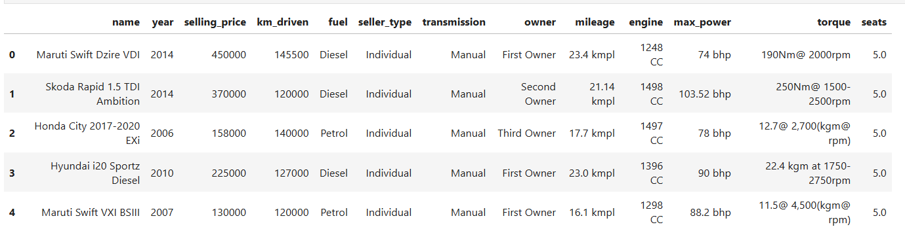
DataSet Details

Slide 4
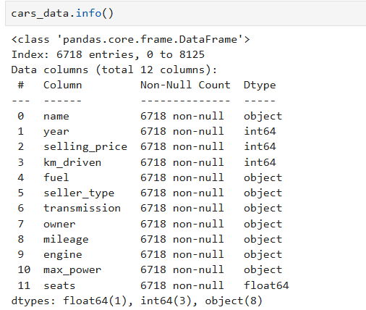
DataSet Details

Slide 5
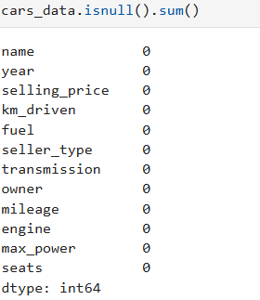
Found Zero null values after EDA

Slide 6
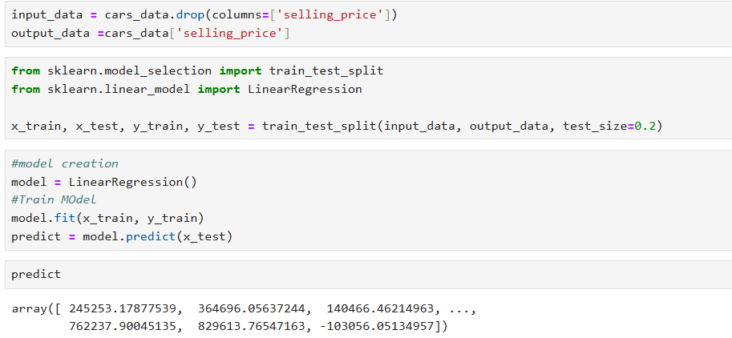
Model Creation And Training

Slide 7
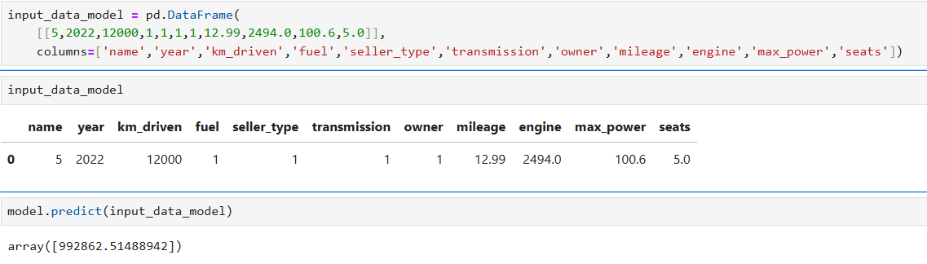

Input
#Importing pickle

Slide 8
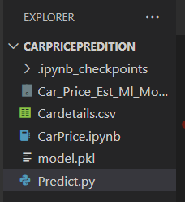
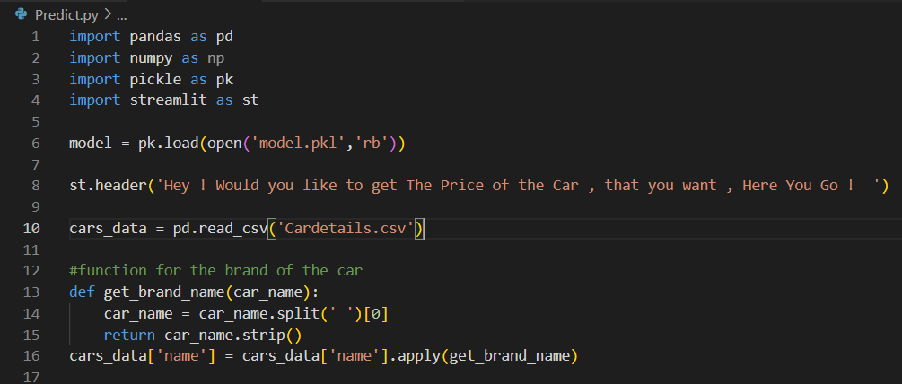
Creation of Prediction environment VS Code

Slide 9

Streamlit app

Slide 10
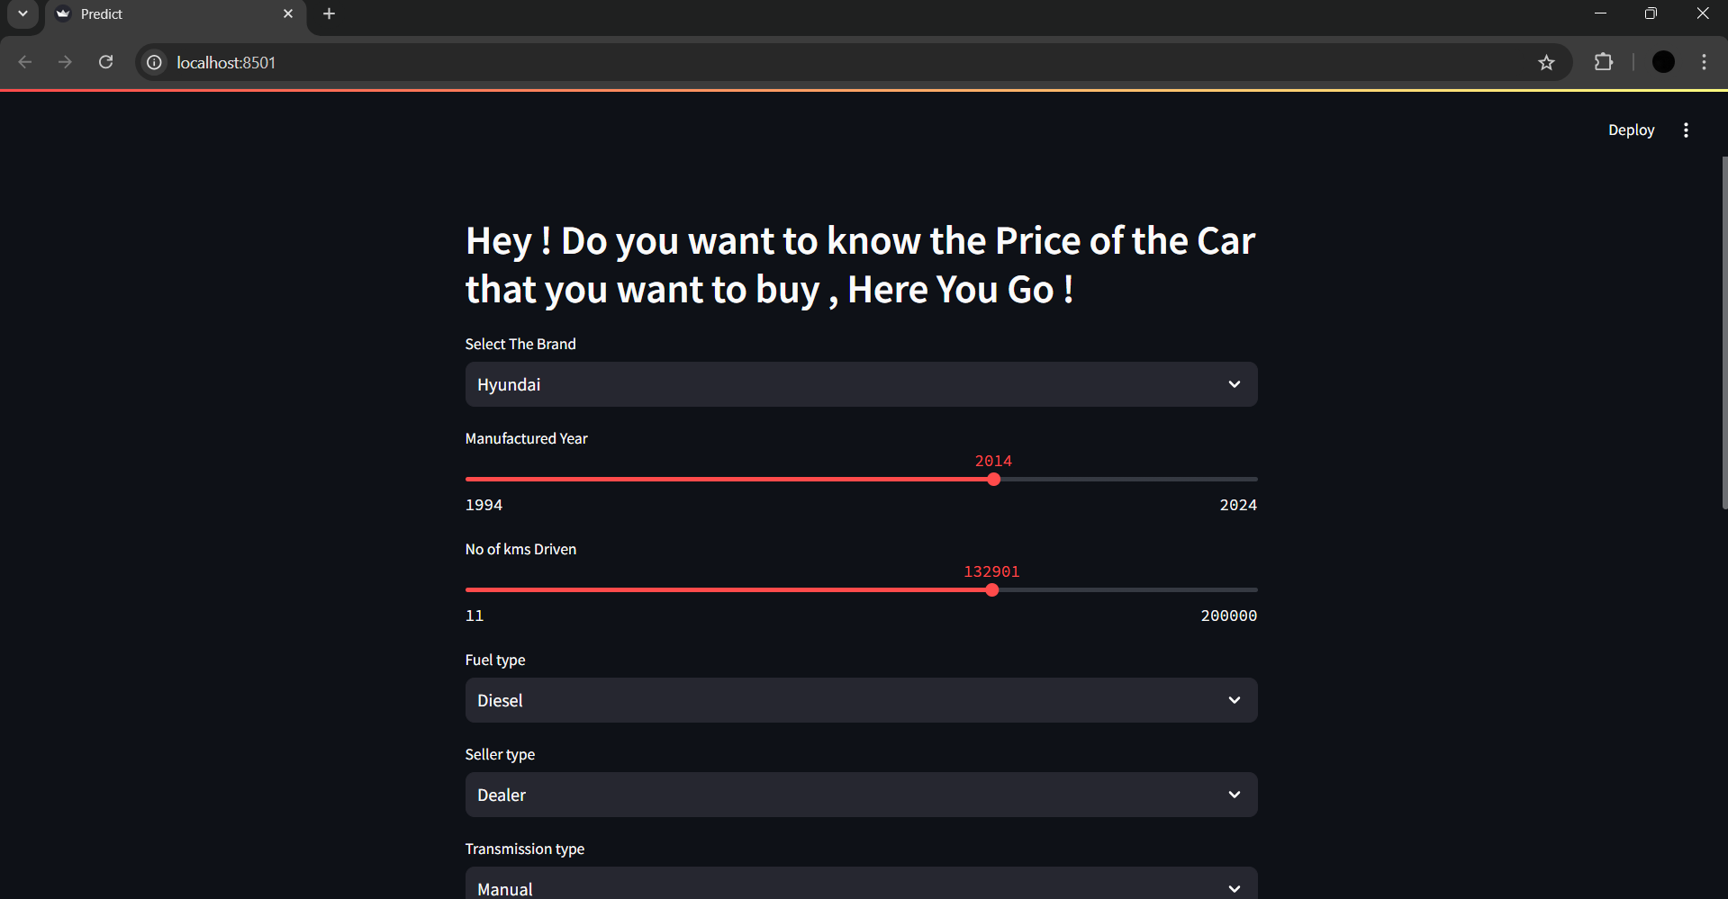

Slide 11
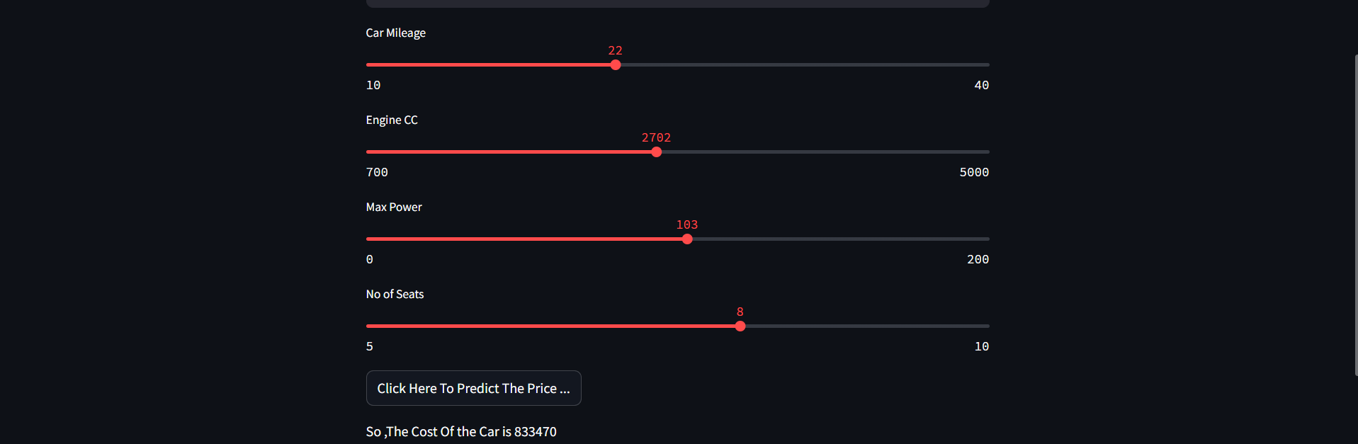
Final Result
The Predicted cost of the car is 83,3,470 /-

Slide 12
Thank you !
Shivaleela K

